Slide 1
Patient Encounter Analysis: Demographics, Utilization, and Preventative Insights
By: Javaris knight

Slide 2
Project Purpose & Objectives
Primary Goal:
To evaluate patient demographic patterns and healthcare utilization drivers across medical practices, identifying where operational resources, clinical interventions, and facility capacity are concentrated most.
Core Objectives:
Demographic Profiling: Identify key age cohorts accessing care and evaluate their service usage.
Resource Allocation: Determine which diagnoses and body systems generate the highest encounter volume and financial claims.
Clinical Risk Identification: Uncover unexpected utilization patterns to inform early screening and targeted preventative care strategies.

Slide 3
Project Analytical Questions
Key Business & Clinical Questions Investigated:
Patient Demographics: How many unique patients are in the dataset?
Condition Prevalence: What are the most common diagnoses or health conditions?
Demographic Trends: Which age groups have the most healthcare encounters?
Utilization Patterns: What is the average number of visits per patient?
Resource Impact: Which conditions or patient groups have the highest healthcare utilization?

Slide 4
How I Used SQL (PostgreSQL)
I used SQL as my primary query and data exploration tool to answer my core business questions.
I wrote SQL queries to filter and join tables, aggregate key metrics, and inspect the database for missing or duplicate values.
Once I executed the queries to retrieve the exact data needed for my analysis, I exported the resulting datasets to bring into Python.

Slide 5
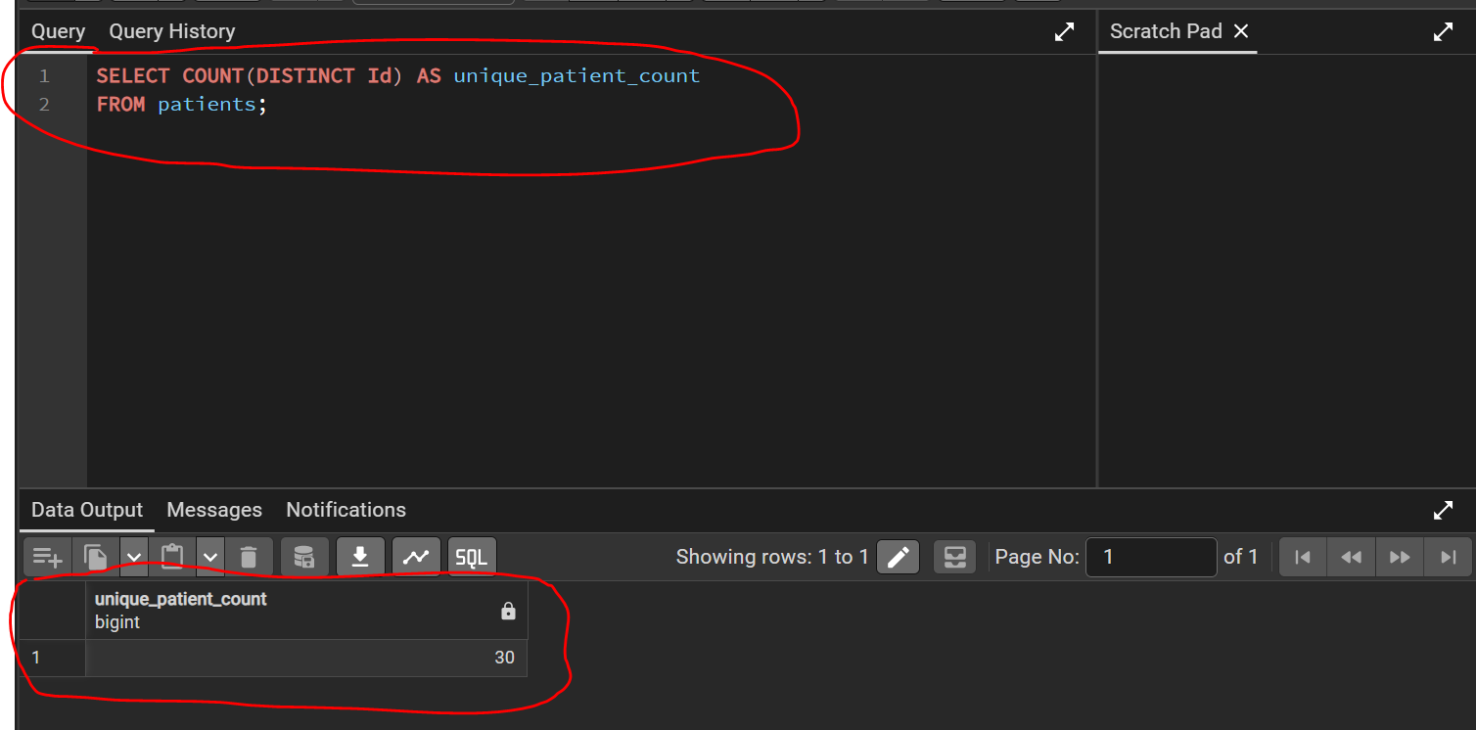
Question 1:How many unique patients are in the database?
SELECT COUNT(DISTINCT Id) AS unique_patient_count FROM patients;

Slide 6
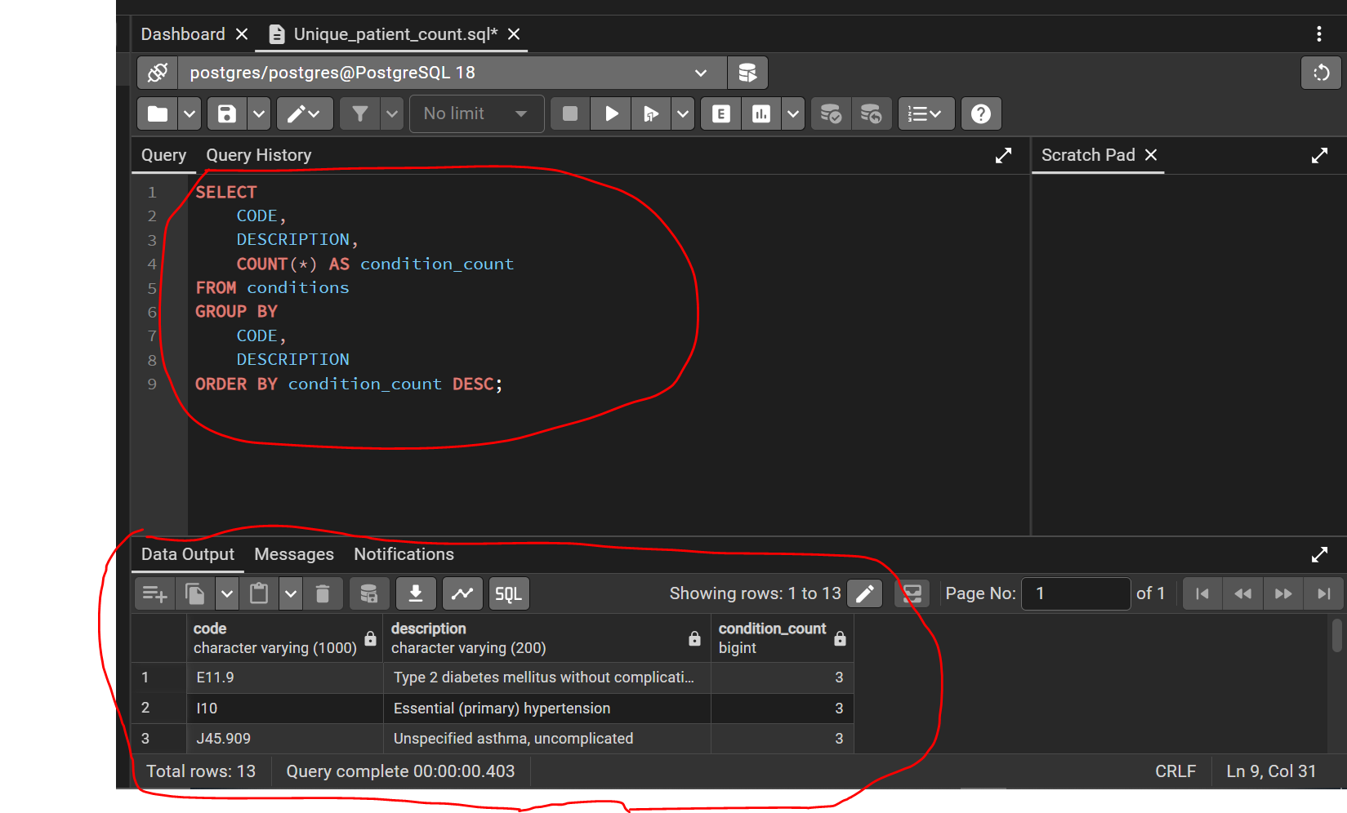
Question 2: What are the most common diagnoses or health conditions
SELECT
CODE,
DESCRIPTION,
COUNT(*) AS condition_count
FROM conditions
GROUP BY
CODE,
DESCRIPTION
ORDER BY condition_count DESC;

Slide 7
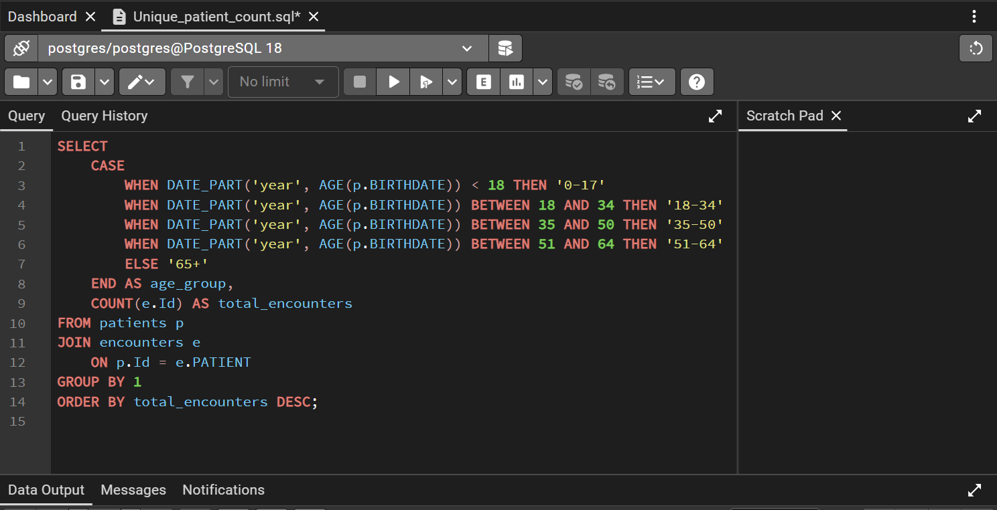
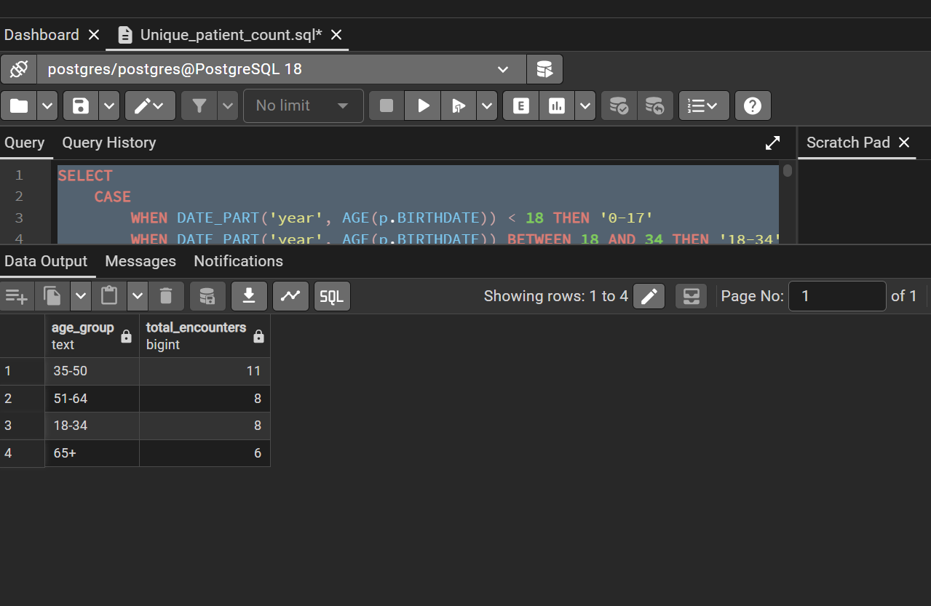
Question 3: Which age groups had the most healthcare encounters?

Slide 8
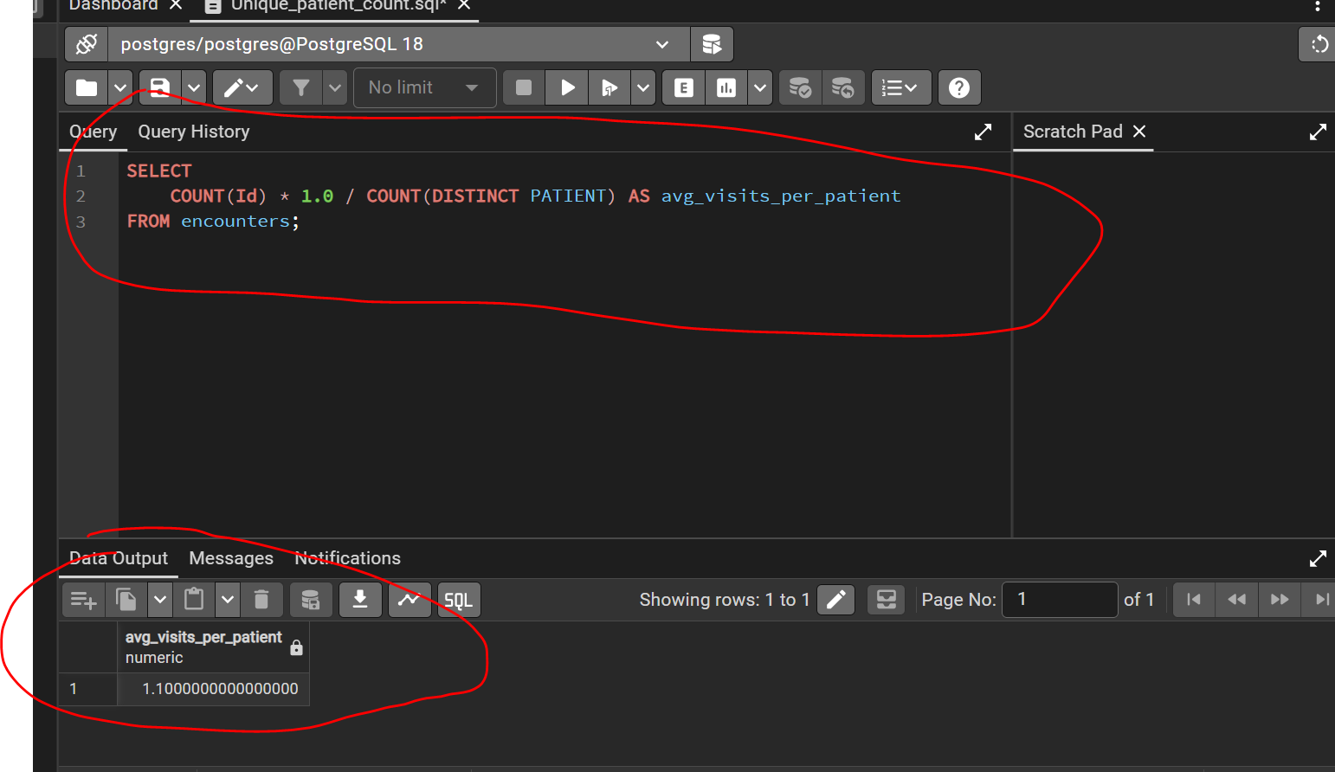
Question 4: What is the average number of visits per patient?
SELECT
COUNT(Id) * 1.0 / COUNT(DISTINCT PATIENT) AS avg_visits_per_patient
FROM encounters;

Slide 9
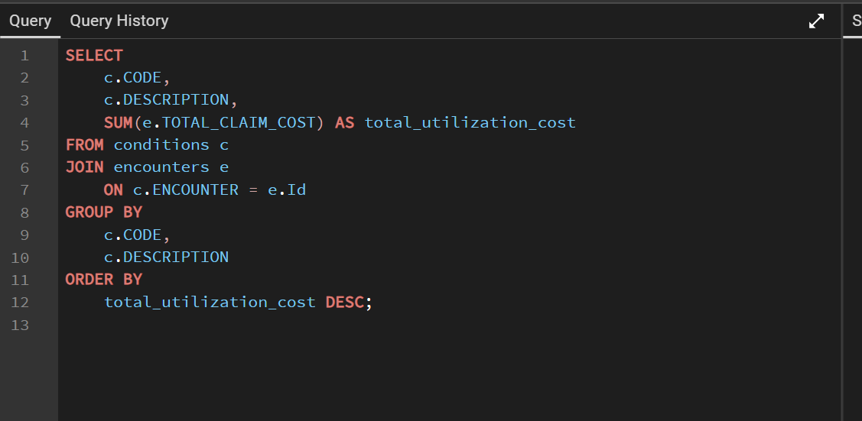
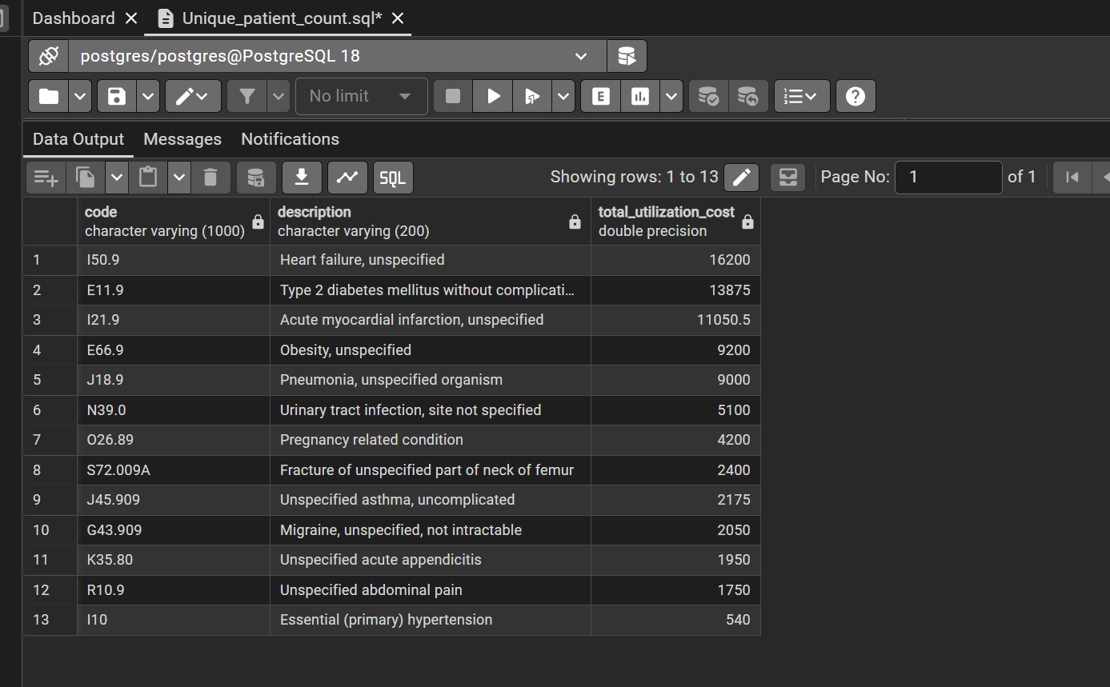
Question 5: Question 5: Which conditions have the highest healthcare utilization (by total cost)?

Slide 10
Dataset Overview
Database Type & Origin:
Synthetic Healthcare Database: Recreated based on Synthea EHR data schemas to simulate real-world patient records and medical practices safely without HIPAA/privacy constraints.
Tutorial & Framework Reference: Learn how Synthea models synthetic electronic health record data on YouTube.
Clinical Scope: Modeled as a general health system database containing patient demographics, clinical visits (encounters), and diagnosed medical conditions.
Core Tables Analyzed:
Patients Table: Contains patient demographic data, including unique IDs (id), birthdates, and geographic location.
Encounters Table: Captures individual outpatient, inpatient, and emergency department visits, tracking encounter dates, visit types, and claim/cost details.
Conditions Table: Records diagnosed medical conditions linked to specific encounters using standardized ICD-10 coding syntax.

Slide 11
Data Limitations
Small Sample Size: The database was limited to only 30 patients. Because of this small sample size, the trends and demographic patterns observed cannot be generalized to a larger real-world patient population or broader health system.
Incomplete Data Columns: Several columns across the tables contained null or missing values, which restricted the scope of variables available for deeper multi-factor analysis.
Synthetic Data Artifacts: Because the dataset was synthetically generated, certain clinical patterns—such as high heart failure rates in younger age cohorts—may reflect algorithm generation rules rather than true epidemiological trends.

Slide 12
Analytical Next Steps
Further exploratory analysis should be conducted on this cohort to evaluate:
Evaluate the prevalence of prior diagnoses—such as uncontrolled hypertension (I10), type 2 diabetes (E11.9), or chronic kidney disease—to understand how co-occurring conditions drive overall patient care needs.
Analyzing these overlapping health conditions reveals complex disease interactions that significantly increase hospital admission rates and overall treatment costs.
Utilization Patterns: Frequency of primary care routine visits versus emergency/inpatient encounters prior to initial heart failure diagnosis.
Expand the dataset beyond the 30-patient synthetic sample to evaluate larger populations and validate statistical trends across broader demographics.

Slide 13
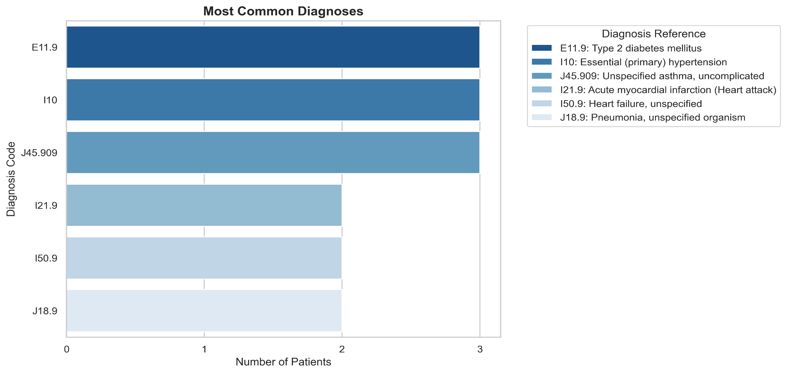
Most Common Diagnoses

Slide 14
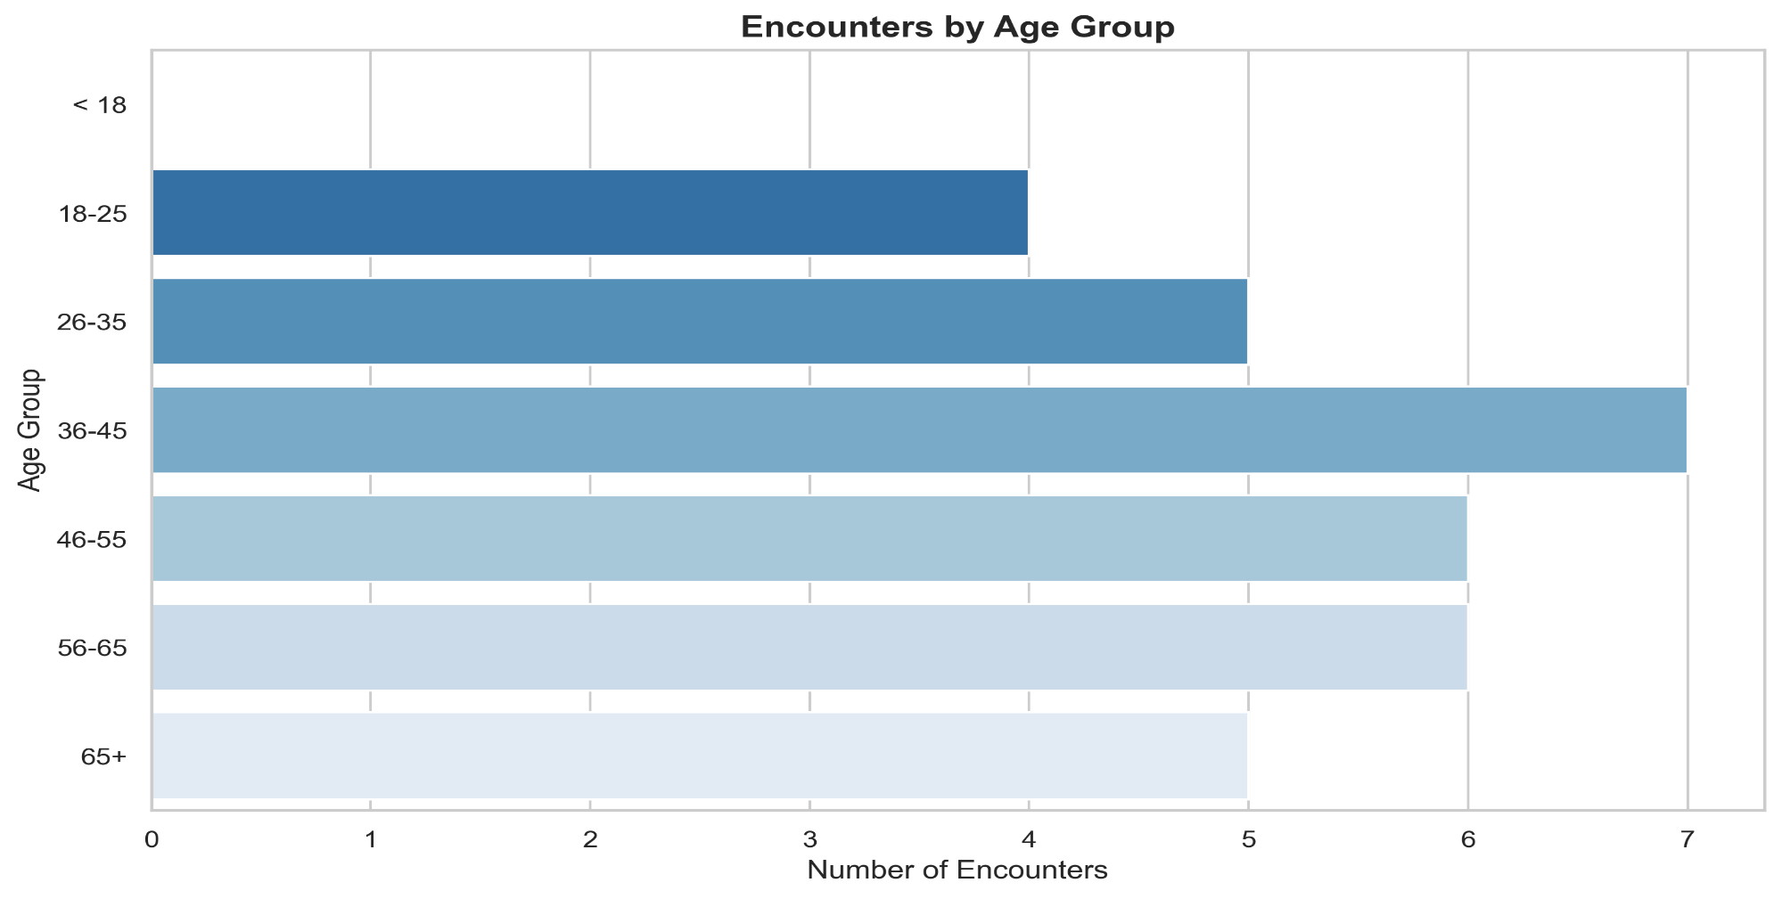
Encounters by Age Group

Slide 15
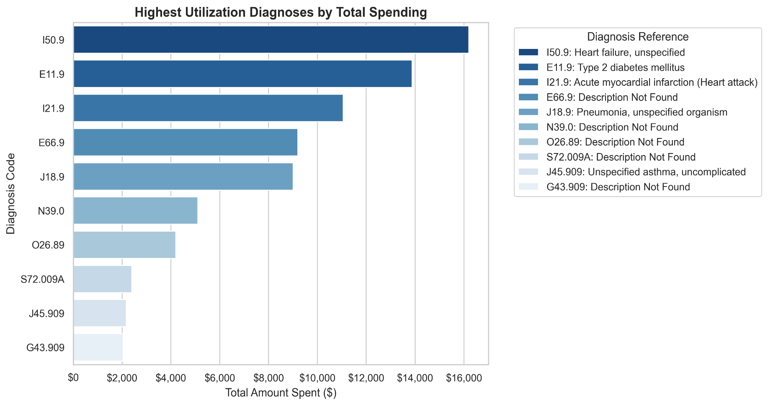
Highest Spending & Utilization

Slide 16
How I Used Python:
I used Python along with the Pandas library to load the clean datasets exported from my SQL queries.
With Python, I validated data types and performed final data transformations before leveraging Seaborn and Matplotlib to build clear, custom visualizations—such as bar plots and demographic distributions—that brought my SQL findings to life visually.

